Slide 1

SleepSynth: Discovering Sleep Patterns with Lifestyle Modeling
and Predictive Analytics
Team# 02:
Suleman khan_(02423029)_Online Affiliation KIST Seoul
Adnan Mumtaz_(02432070)_ Online Affiliation KITECH
M. Farooq_(02323027)_ Online Affiliation KIMM
Professor’s
Eunhui Kim Affiliation KISTI Daejeon
Insung Ahn Affiliation KISTI Daejeon
Jeong Yuna Affiliation KISTI Daejeon
Notes:
Have you ever wondered how the simple choices we make each day—like scrolling on our phones before bed, or spending hours seated at a desk—might impact our sleep?

Slide 2
Content
Introduction
Literature Review
Project Overview and Data Collection
Data Analysis
Modeling
Target
Timeline

Slide 3

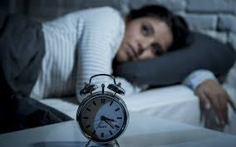
Introduction
The Sleep Crisis: Poor sleep is linked to multiple health issues, from mental health decline to reduced cognitive function.
Current Knowledge: While some lifestyle factors (like exercise) are known to affect sleep, modern habits
(e.g., screen time, technology use) are less studied.
Key Challenge: How can we leverage lifestyle data to better understand and predict sleep quality?

Slide 4
Literature Review
Impact of Lifestyle on Sleep Quality:
Exercise and Sleep: Studies show regular exercise improves sleep duration and quality. However, the timing and intensity may have varied effects (e.g., Chen et al., 2021).
https://doi.org/10.1080/21679169.2019.1623314
Screen Time Before Sleep: Exposure to screens before sleep can delay melatonin release, leading to poorer sleep quality and reduced duration (Carter et al., 2016).
https://www.researchgate.net/publication/309617812_Association_Between_Portable_Screen-Based_Media_Device_Access_or_Use_and_Sleep_Outcomes_A_Systematic_Review_and_Meta-analysis
Current Predictive Models for Sleep Patterns:
Machine Learning Models: Evaluating Machine Learning Models for Predicting Sleep Disorders in a Life Style and Health Data Context (Gregorius Airlangga., 2024).
https://www.researchgate.net/publication/380275509_EVALUATING_MACHINE_LEARNING_MODELS_FOR_PREDICTING_SLEEP_DISORDERS_IN_A_LIFESTYLE_AND_HEALTH_DATA_CONTEXT

Slide 5


Project Overview
Key Gaps in Research:
Limited exploration of modern lifestyle factors (e.g., increased screen time, sedentary behavior) on sleep.
Need for more comprehensive models that can provide real-time, actionable insights for diverse populations
Objective:
Investigate the impact of daily lifestyle habits on sleep quality using data-driven approaches.
Better understanding of sleep patterns could lead to personalized recommendations for improved sleep and health.
Focus Areas:
Exercise habits
Technology use (screen time before sleep)
Sleep disturbances

Slide 6

Data Collection Plan
Available data & Survey Design:
Collect Publicly Available data
Launch survey and gather sufficient data (Collect data from as much as participants possible)
Make a Big Dataset
Data Points: Sleep duration, sleep quality, exercise frequency, screen time, and more.
Platform: Distributed through an online survey in multiple languages (English, Korean, etc.).

Slide 7
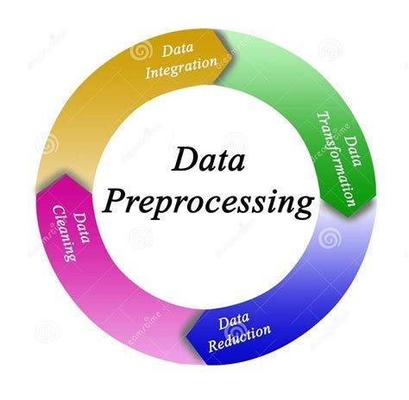
Understanding & Data Analysis
Data Analysis:
Clean and preprocess survey responses.
Combine the Publicly available data and the Survey data we collected
Conduct correlation analysis to identify significant relationships between lifestyle habits and sleep quality.
Perform statistical analysis on collected data to understand the data nature.
Expected Outcomes: Key variables which are closely related to sleep quality and health issues.
Notes:
(e.g., translation, normalization of values)
(Spearman, Pearson)

Slide 8

Modeling
Modeling: Begin initial machine learning model development for predicting sleep quality based on lifestyle factors.
Investigate: Try to Investigate and improve data quality for ML models.
Techniques: Try to apply different techniques we learn in the class.

Slide 9
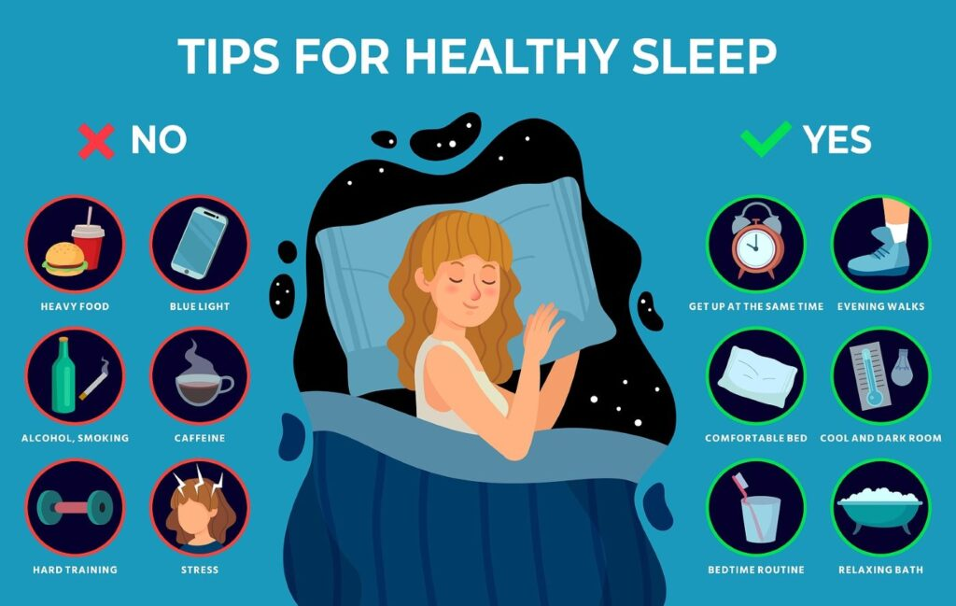

Target Output
Potential Impact:
Insights of how daily routine impact sleep
Helping individuals to improve their health through lifestyle adjustments.
Help individuals to be safe from different health issues in early life.
Significance Outcome: This study can form the basis for building personalized sleep recommendations using predictive analytics.

Slide 10

Timeline
 | Week# 8 17 Oct~24 Oct | Week# 9 24 Oct~31 Oct | Week# 10 31 Oct~07 Oct | Week# 11 & 12 07 Oct~21 Oct | Week# 13 21 Oct~28 Oct | Week# 14 28 Oct~05 Oct | Week# 15 05 Oct~12 Oct | Week# 16 17Oct~24Oct
Idea Discussion
Finalization & Proposal Presentations
Data Collection
Data Analysis
Data Modeling
Data Visualization & Review
Prepare Final Report
Submission and Presenting Final Outcomes

Slide 11
Thank you ☺

